Slide 1
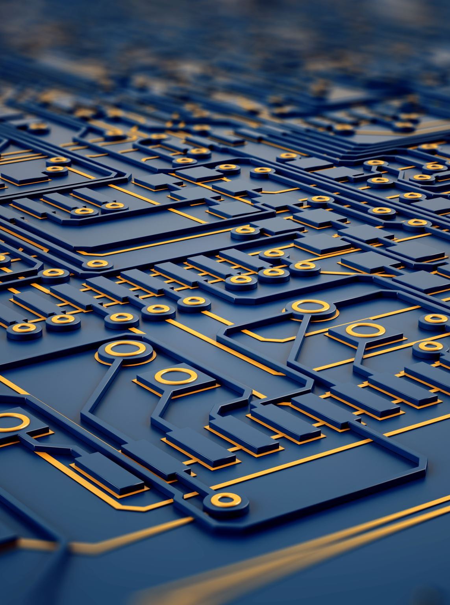
Image Segmentation
Detecting defects in the industry
Team Mnemonic (A)

Slide 2
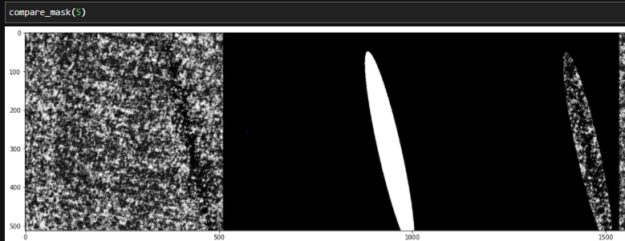
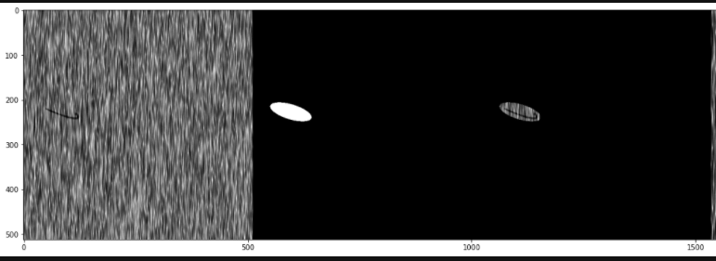
The Dataset
1250 images and mask
Dimensions: 512x512
8 Patterns
Unbalanced
Test: 50 images for each pattern

Slide 3

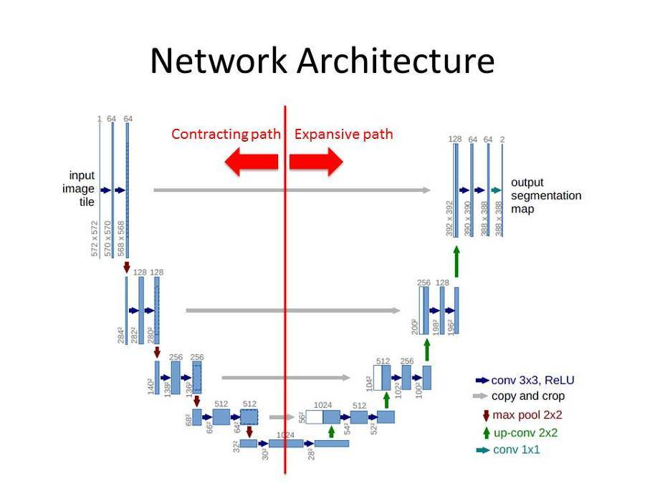

Architecture
U-net

Slide 4
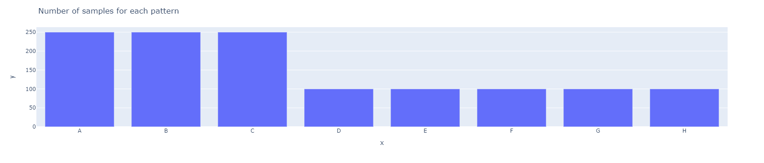
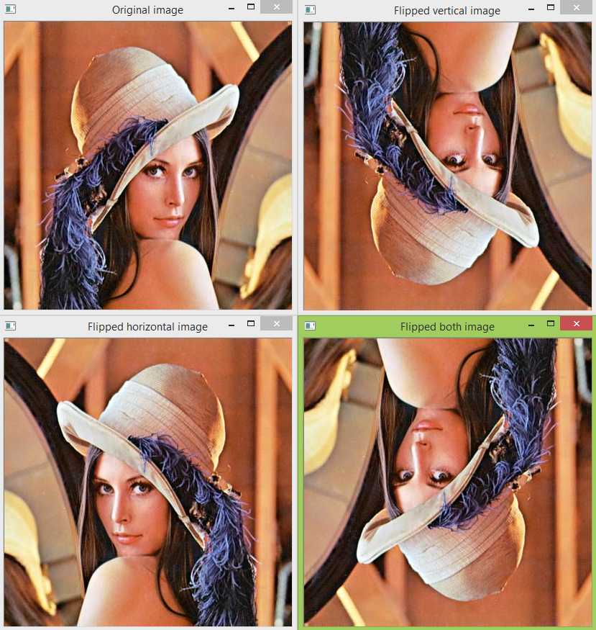
Data Augmentation
Minority Classes
Total = 2,450 images
Balance reach

Slide 5
Optimal Image Size
96x96
Bad
128x128
Not bad
Training
256x257
Good
512x512
Very good

Slide 6
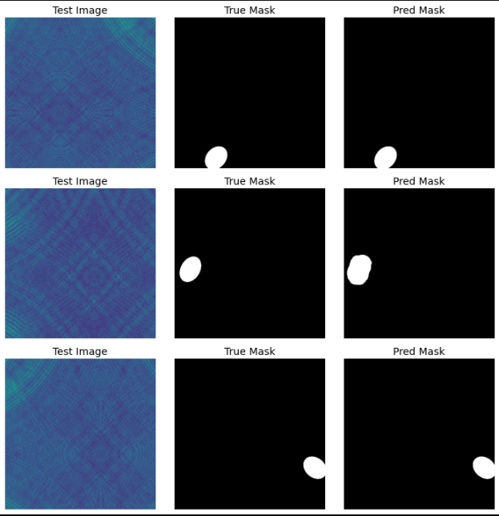
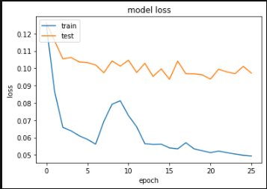
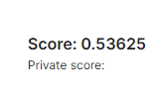
Results

Slide 7
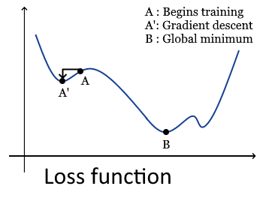
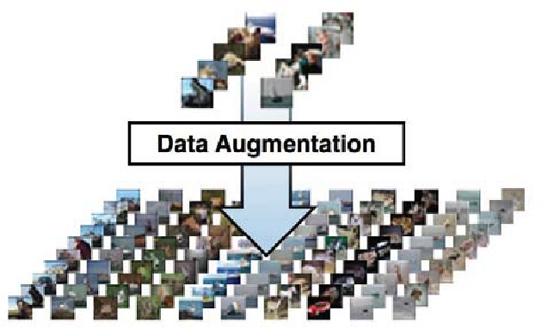
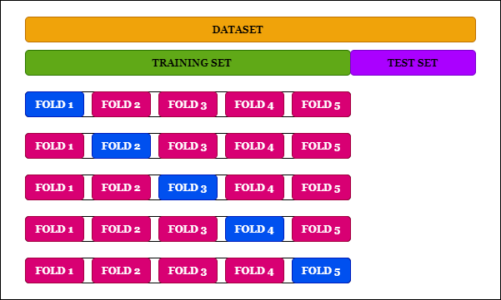
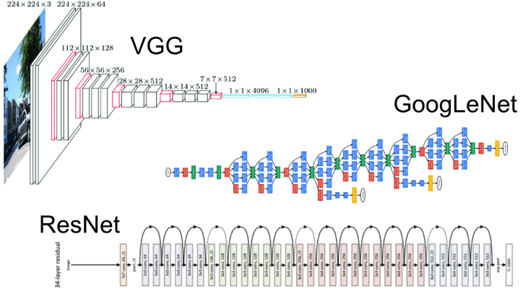
How to improve?

Slide 8
Thank you!

